Slide 1
Lyndon B. Johnson’s Presidency
1963-1969

Slide 2
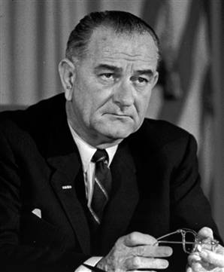
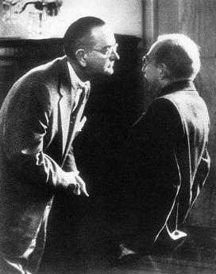
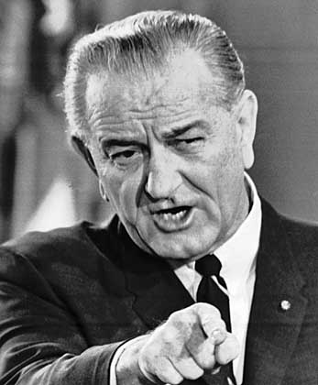
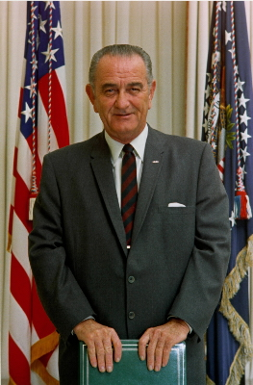
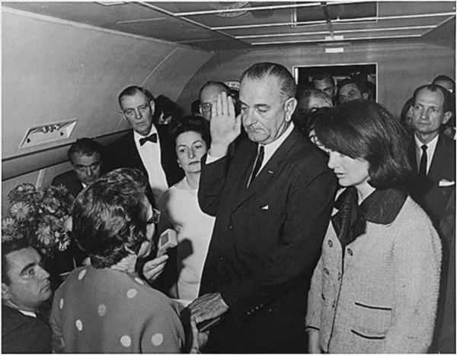
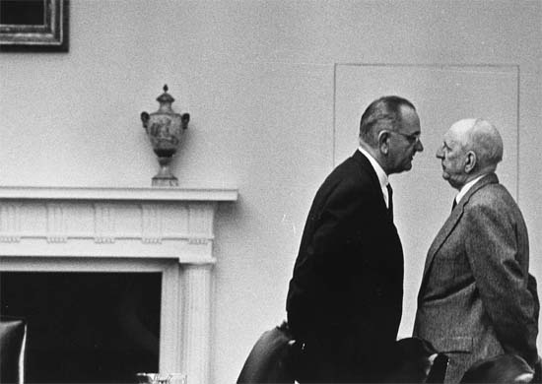
LBJ

Slide 3
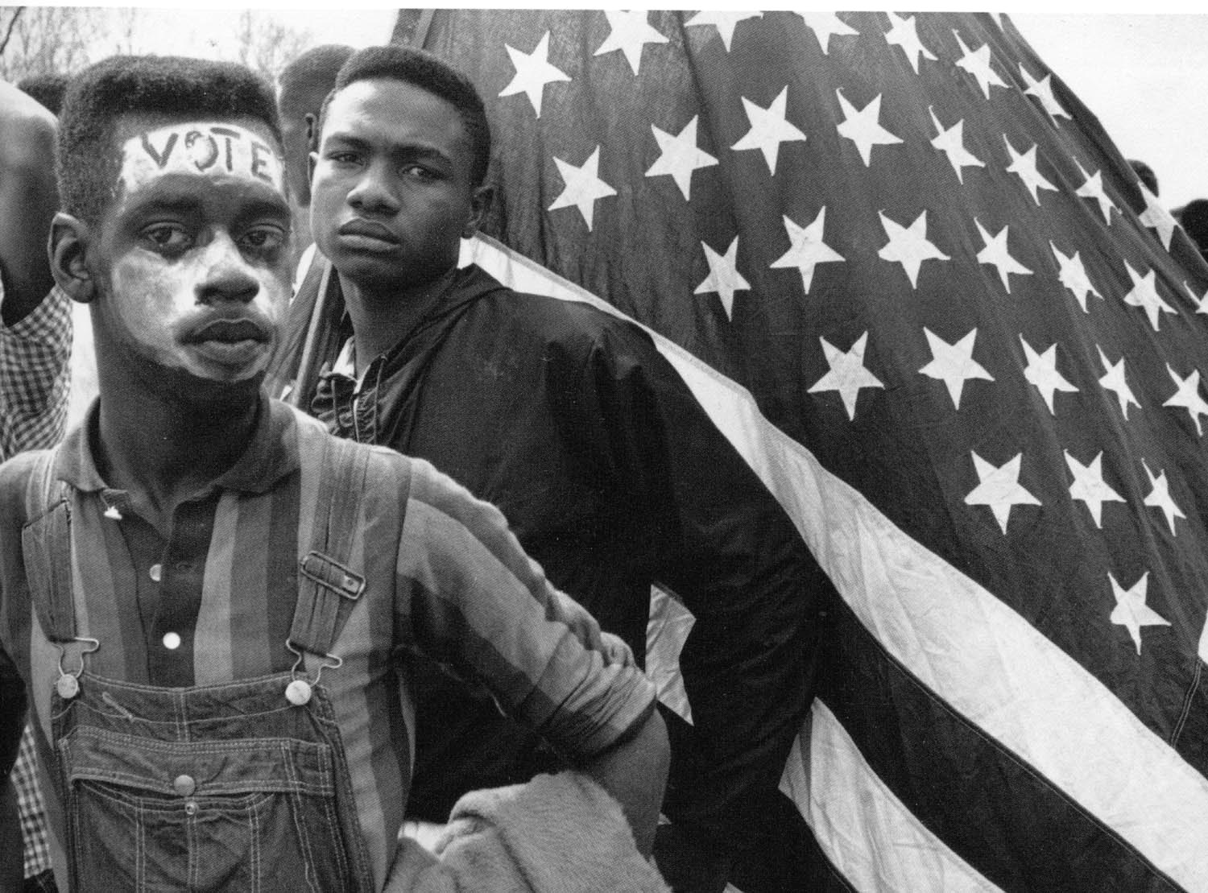
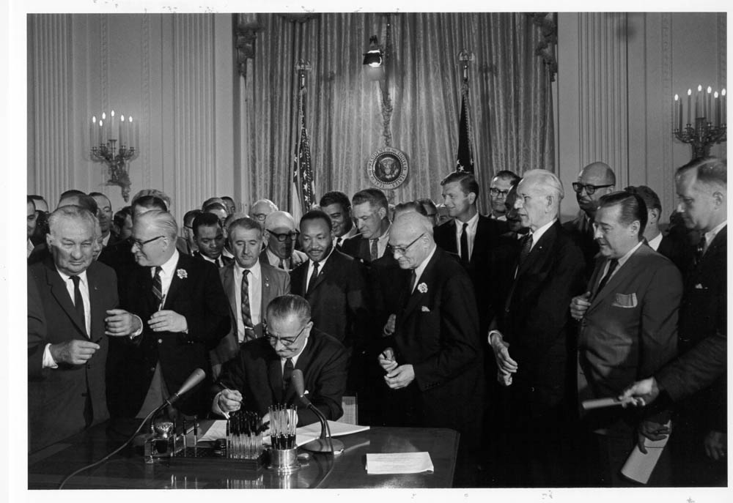
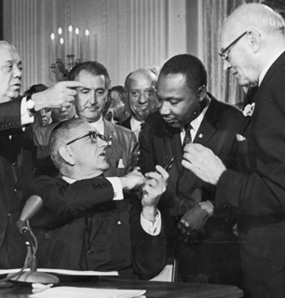
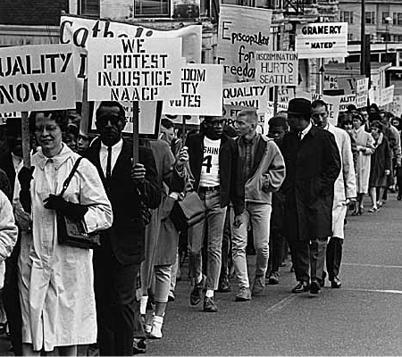
The Great Society
Domestic Social Program to equalize opportunity in the U.S.
Civil Rights Act
Voting Rights Act
Economic Opportunity Act
Medical Care Act

Slide 4
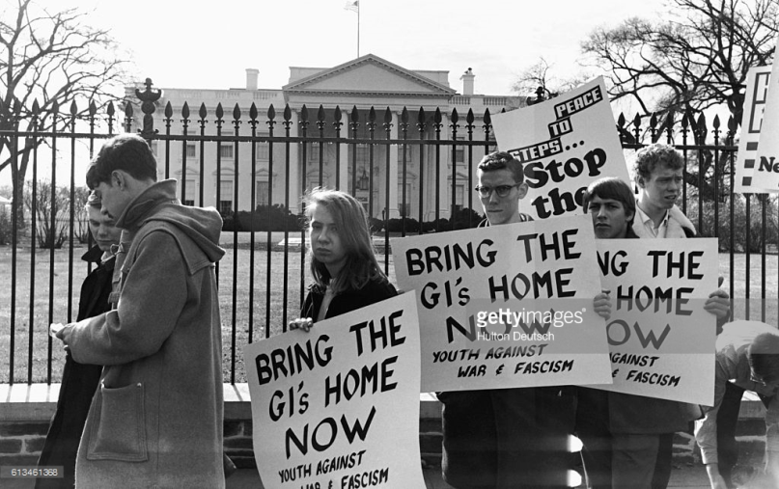
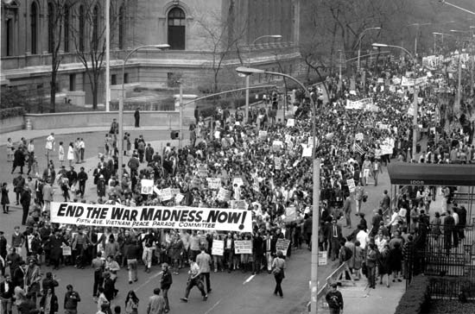
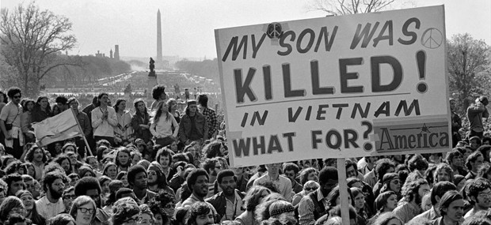
Vietnam War
Participation in Vietnam led to decreased funding for the Great Society
Weighed heavily on LBJ’s conscience
“Hey, hey, LBJ, how many kids you kill today?”
Did not seek re-election in 1968

