Slide 1
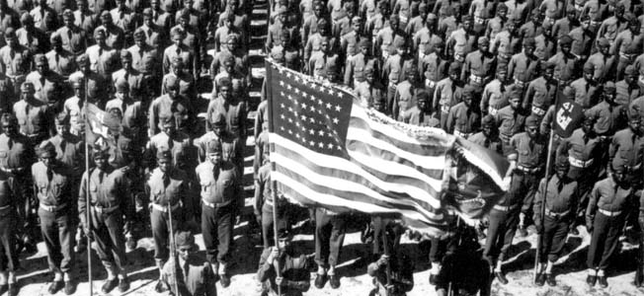
United States during World War II
Homefront

Slide 2
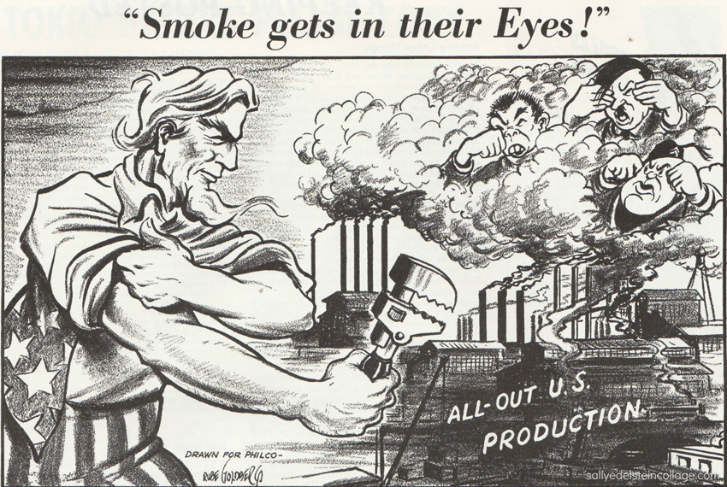
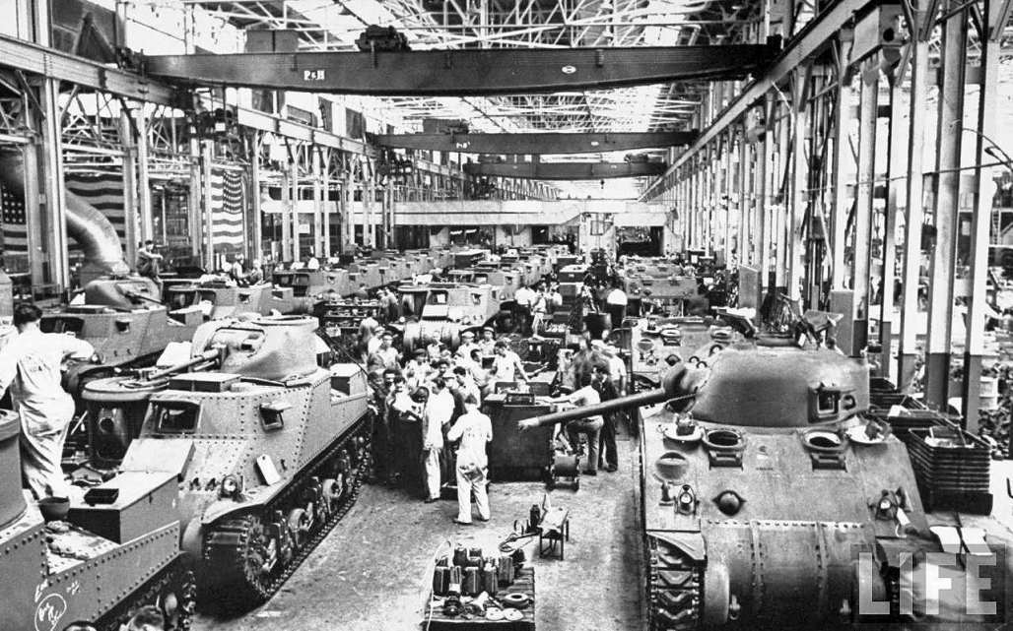
Mobilization
Japan attacks the U.S. at Pearl Harbor
Brings the U.S. into the war
U.S. instantly begins mobilizing for war
By summer 1942, almost all major industries and some 200,000 companies had converted to war production
Auto Industry- converts factories to production of military equipment
Vehicles, artillery, rifles, mines, helmets, airplanes

Slide 3
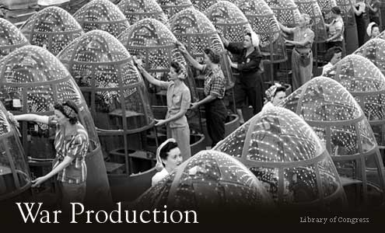
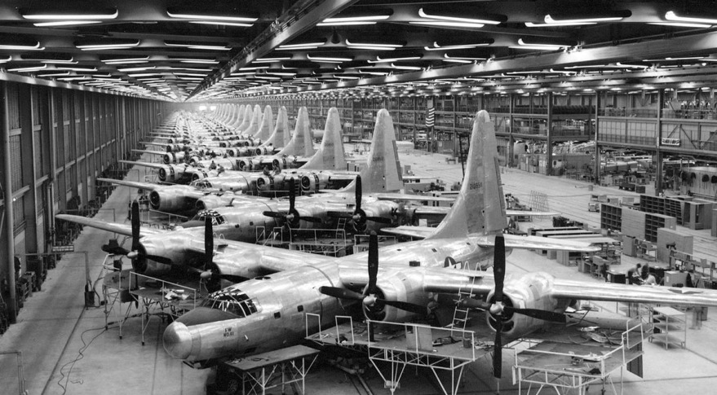
War Production Board
Set priorities and production goals
controlled the distribution of raw materials and supplies
Supervised the production of $185 billion in military weapons and supplies

Slide 4
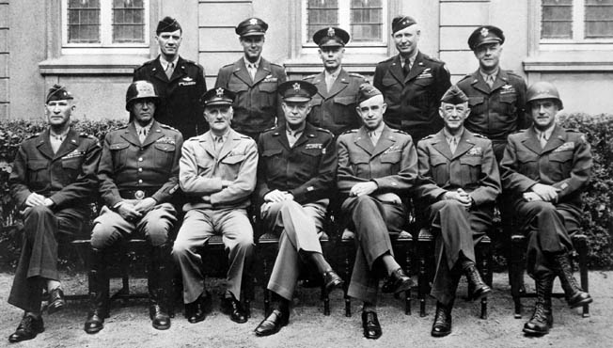
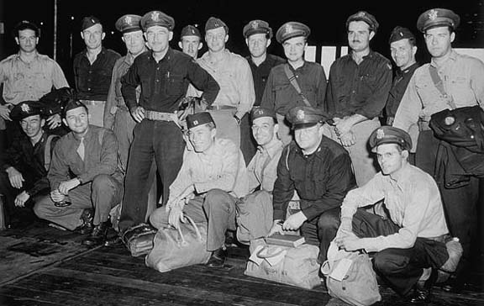
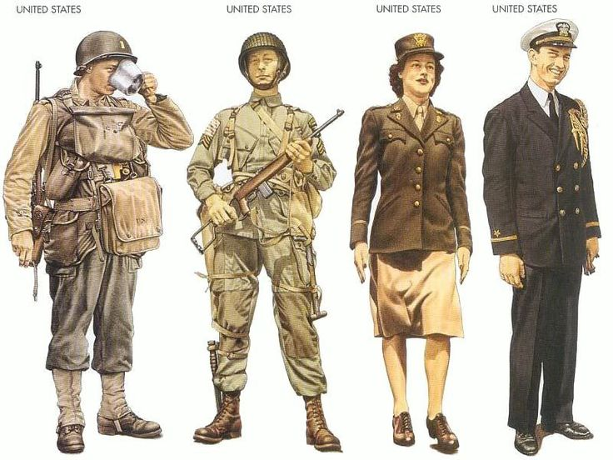
Building an Army
Selective Service and Training Act
September 1940
**“GI” = “Government Issue” was printed in uniforms which is why American soldiers called “GI”s
Segregated Military
White Officers in command of black units
Double V Campaign- “Victory over Racism at Home” and “Victory over Fascism abroad”
Women in military- May 1942
Women’s Army Auxiliary Corps (WAAC) →WAC

Slide 5
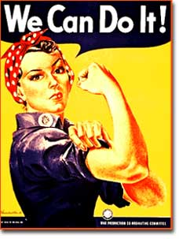
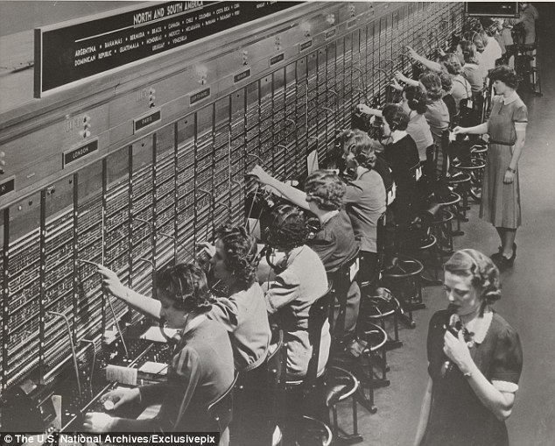
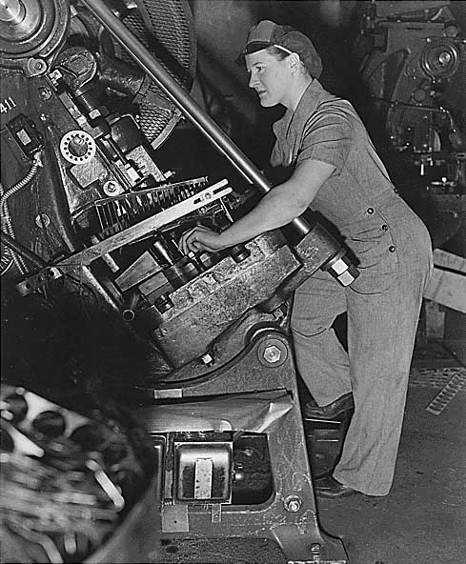
Women in Industry
19 million new jobs created with war
2.5 million women worked in shipyards, aircraft factories and manufacturing plants
“Rosie the Riveter” becomes symbol of war

Slide 6
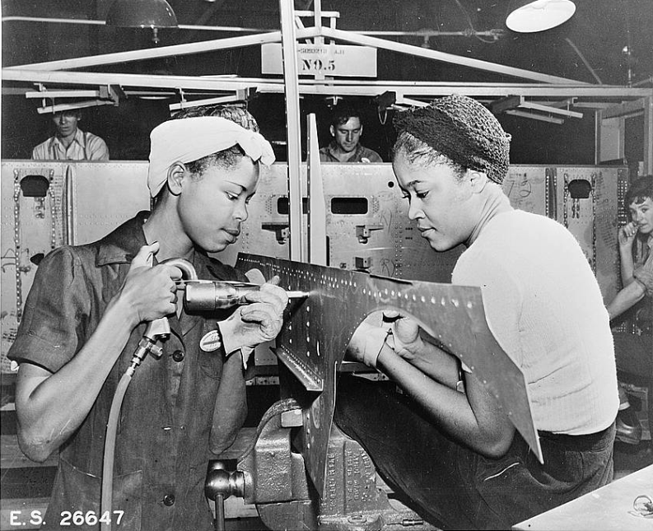
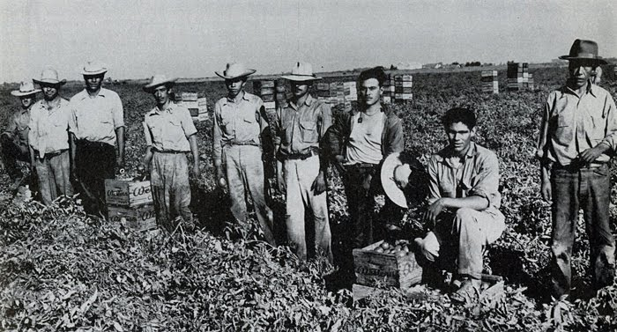
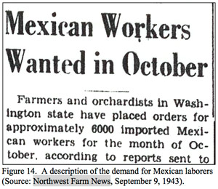
Minorities in the Workforce
Fair Employment Practices Commission
Executive Order 8802- no discrimination in defense industries
First Civil Rights agency since Reconstruction
African-Americans fill factory jobs → Great Migration
Bracero Program (1942)
Over 200,000 Mexicans came to U.S. to help with labor shortage in agriculture

Slide 7
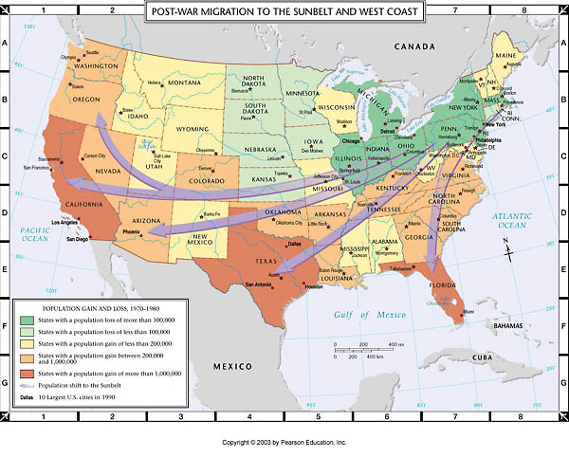
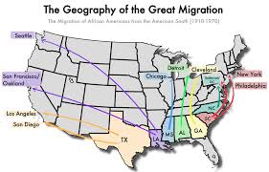
Migration of Americans
15 million Americans moved during the war
Sunbelt- new industrial region in South and West
Great Migration
Racial Violence explodes in cities

Slide 8
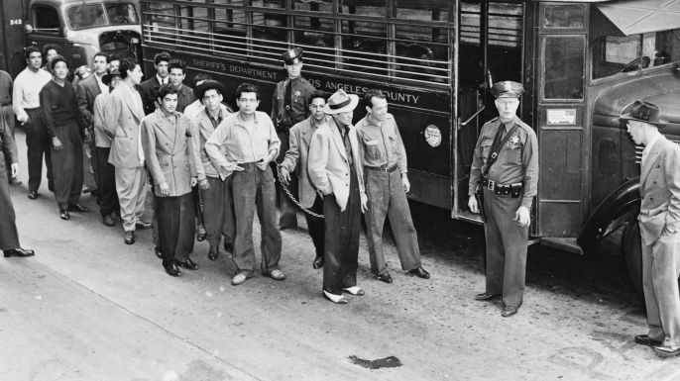
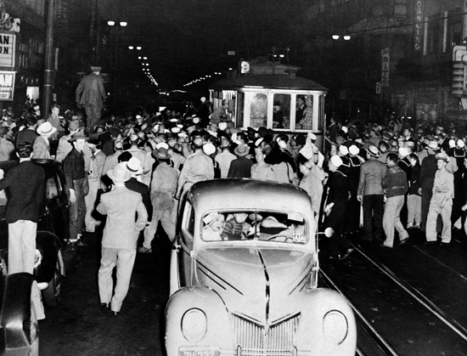
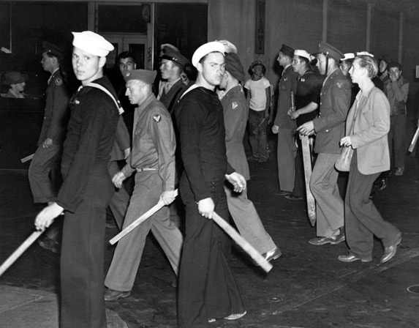
Zoot Suit Riots
Racial tensions prevalent
Zoot Suit- baggy suit (bc so much fabric was seen as “unpatriotic”)
2500 sailors and soldiers stormed into Mexican American neighborhood in L.A.
Violence continued for days and Zoot Suit was banned in L.A.
*500,000 Hispanic Americans served in Armed Forces

Slide 9
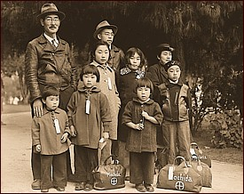
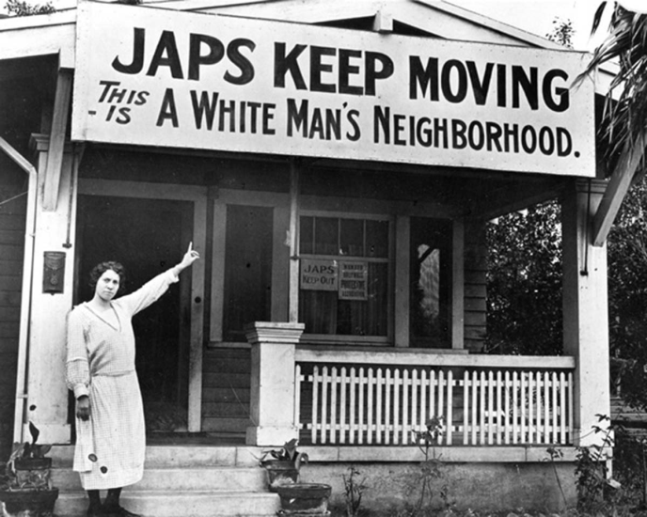
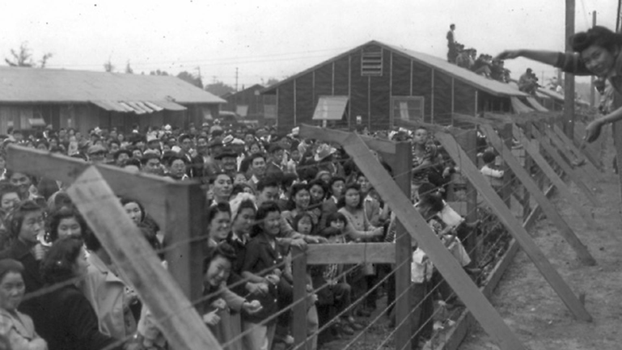
Japanese American Relocation
After Pearl Harbor- suspicion of Japanese Americans high
FDR ordered all Japanese Americans be removed from West Coast – Executive Order 9066
Sent to 10 internment camps
Korematsu v. United States
Supreme Court upheld constitutionality of relocation bc of “military urgency” not race

Slide 10
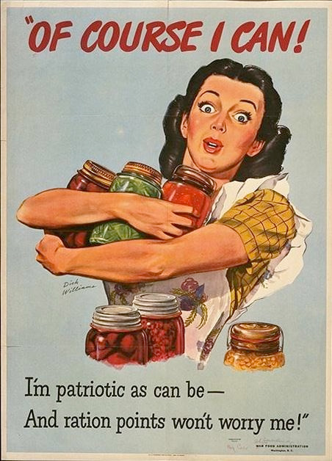
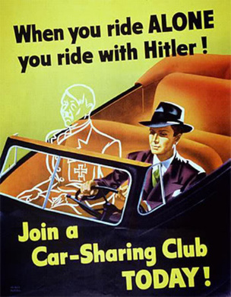
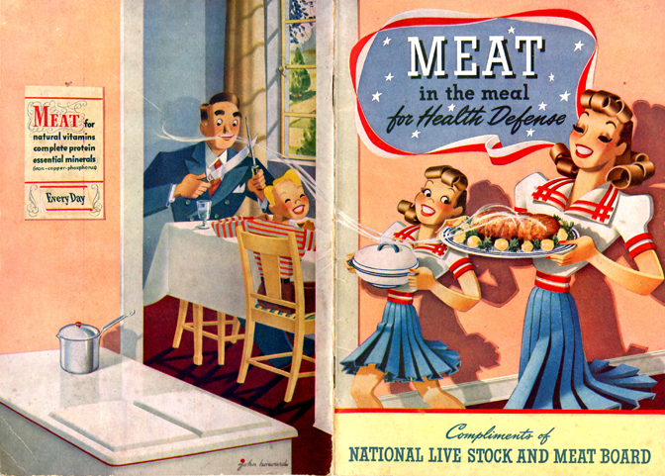
Daily Life
Housing shortages in cities
Wage and Price Controls
War Labor Board helps mediate wage disputes instead of workers striking
Victory Gardens
Rationing
Red coupons & Blue coupons
Doing without so the troops have enough
War Bonds
$18.75 → $25 after 10 years

