Slide 1
World War I
1914-1918

Slide 2
MAIN Causes of WWI
Militarism – the aggressive build-up of a nations armed forces.
Alliances – nations formed partnerships to help protect and defend themselves.
Imperialism – stronger nations began to take over weaker nations.
Nationalism – everybody thought their nation was the best.

Slide 3
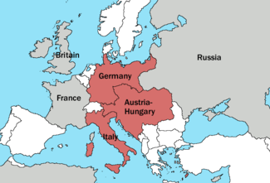
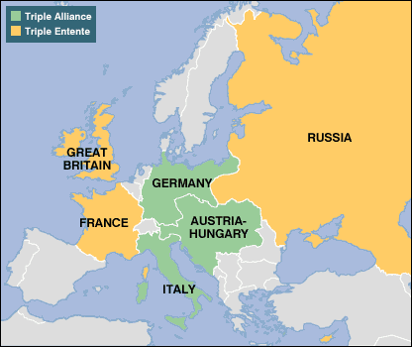
Tension Builds…
Triple Alliance (1882)
Germany
Austria-Hungary
Italy
Triple Entente (1907)
Great Britain
France
Russia

Slide 4
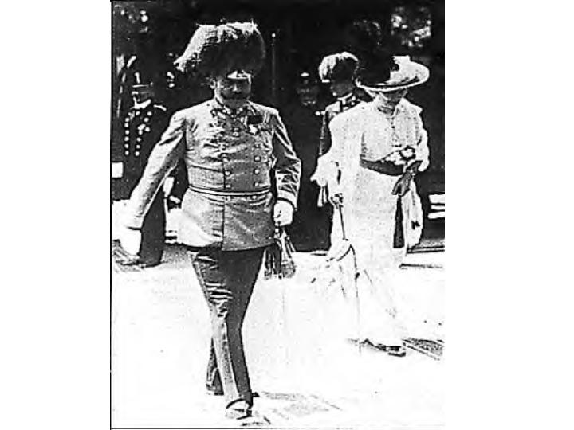
Short-Term Cause
June 28th 1914
Assassination of Franz Ferdinand

Slide 5
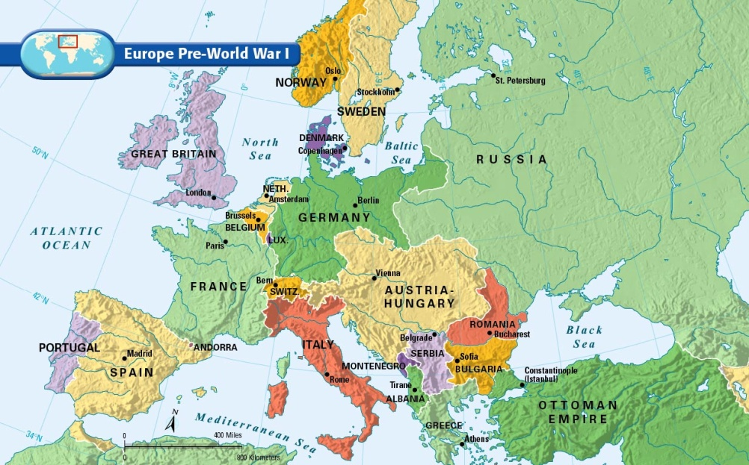
Who Declared War on Who?
Austria-Hungary Declares War on Serbia
Russia Declares War on Austria Hungary
Germany Declares War on Russia
Germany Declares War on France
England Declares War on Germany and Austria Hungary

Slide 6
The Two Sides
Triple Alliance
Germany
Austria-Hungary
Italy
Central Powers
Germany
Austria-Hungary
Ottoman Empire
Triple Entente
England
France
Russia
Allied Powers
England, France, Russia, Italy, United States (1917),
Serbia, Belgium

Slide 7
Which side should the US pick?
Central Powers:
Allied Powers:
11 million German-Americans
Irish-Americans hated Great Britain
Close cultural ties
Shared transatlantic cables (so censored stories)
Big business loaned a lot of $ to Allies
US Exports to both sides:

Slide 8
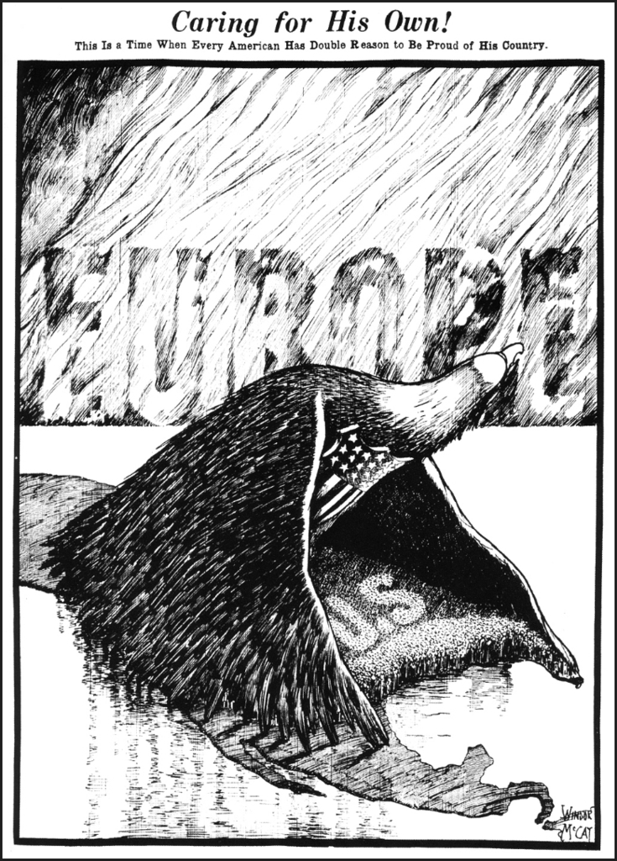
Why did it take so long for America to get involved in the war?
America was isolationist
“Why should I get involved in someone else’s problems”
Is isolationism really an option for a country as powerful as the United States?

Slide 9
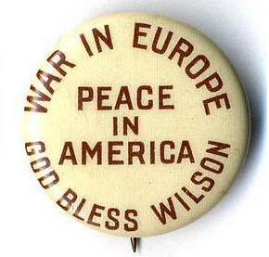
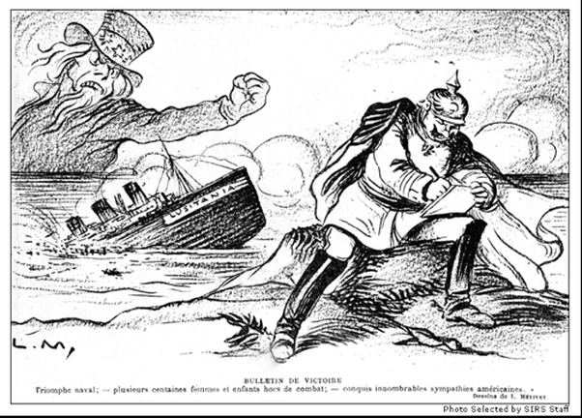
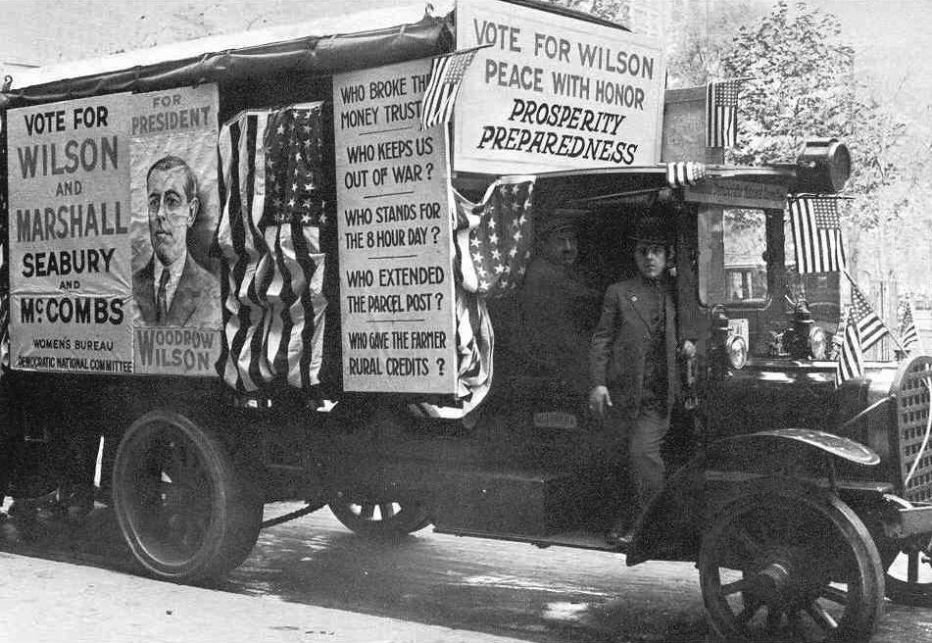
United States remains neutral
Woodrow Wilson: “Remain neutral in thought as well as deed”
To protect international trading rights
“He kept us out of war.” Wilson’s 1916 presidential campaign slogan

Slide 10
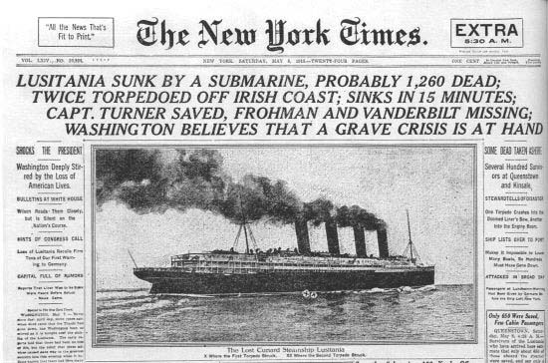
U.S. Neutrality under fire
British blockade of North Sea
Germans engage in submarine (u-boat) warfare
Lusitania crisis (May 1915) British liner sunk by German U-boats
Arabic and Sussex sinkings (Germans issue Sussex Pledge)
Economic ties with Britain and France - war time trade and US financing of Allied war effort

Slide 11
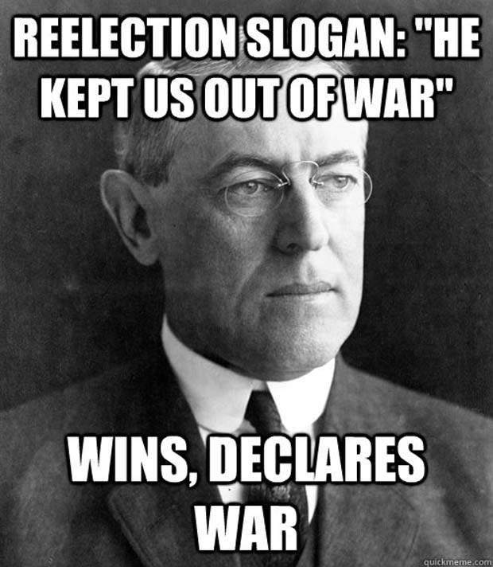
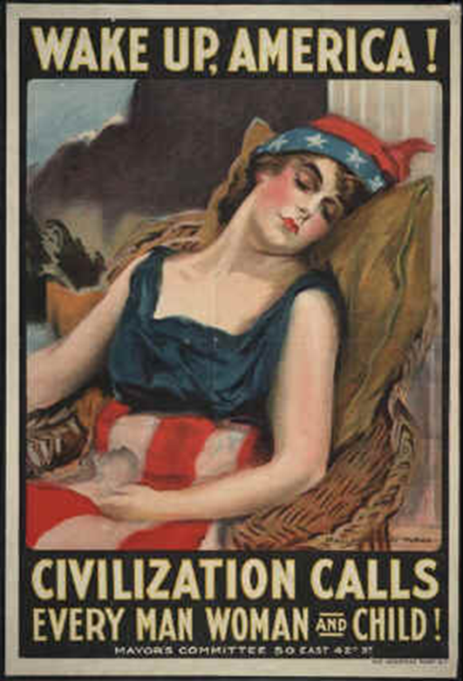
Election of 1916
“He Kept Us Out of War”
Peace efforts had failed
Wilson narrowly won
January 1917, “Peace without Victory” Speech
April 1917, Wilson asked for declaration of war.

Slide 12
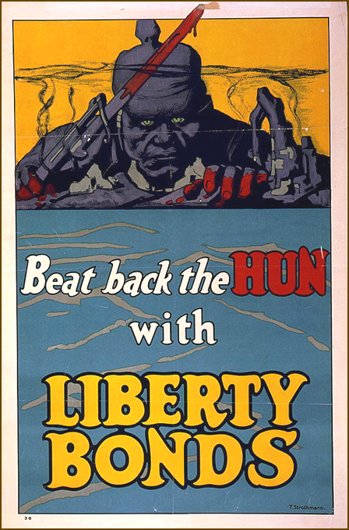
Shifting US public opinion
Reports of German cruelty (Huns) reinforced by Lusitania
Ethnic loyalties
Native born Americans (not Indians) favored Britain and French victory
British War Propaganda
Pro-War politicians (TR)

Slide 13
From Neutrality to War
Zimmermann Telegram (1917)
Russian Revolution (1917)
Unrestricted Submarine Warfare
“The World Must be made safe for Democracy” (Progressive crusade)

Slide 14
Mobilization in the USA
War Industries Board (Bernard Baruch) coordinated production and price controls
Food Administration (Herbert Hoover) voluntary efforts to conserve food for soldiers
Financing - Liberty Bonds

Slide 15
Wartime Public Opinion
Committee on Public Information - propaganda agency in America (George Creel) “do your bit” for the war
Hate the Hun, Liberty Cabbage, Salisbury Steak, Can the Kaiser

Slide 16
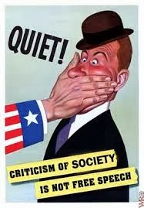
Wartime Civil Liberties
Espionage and Sedition Acts (1917-18) jail sentences for those critical of disloyal or abusive remarks toward US war effort
Schenck v. United States (1919) “clear and present danger” - free speech could be limited

Slide 17
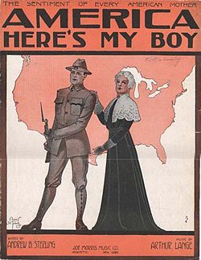
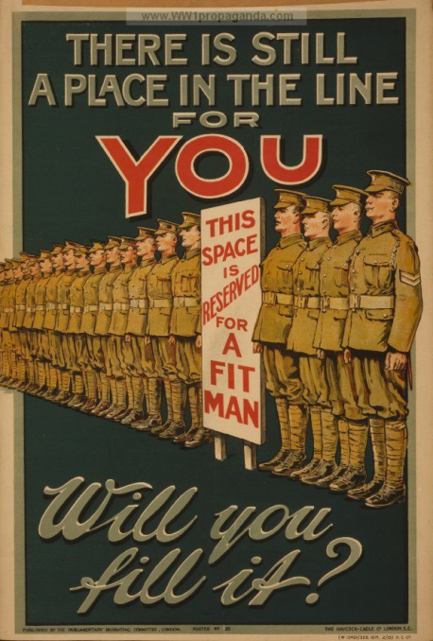
The Armed Forces
Selective Service Act (1917) draft: 2.8 million draftees, 2.9 million volunteers
Eventually 2 million were sent to Europe
Blacks - 400,000 served, few officers
Blacks hoped for service abroad = equal rights at home (not so)

Slide 18
American Society
Women took men's jobs while men were “Over There” led to Nineteenth Amendment
Mexicans - left Mexico (upheaval and revolution) and took jobs in American West
Blacks - Great Migration to northern cities for job opportunities and to escape poverty

Slide 19
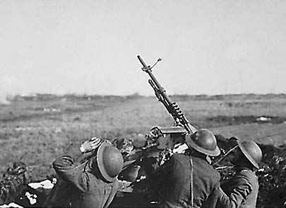
Fighting the War
New style of warfare: mechanized
Machine guns
tanks
long-range, heavy artillery
poison gas (various types)
Trench warfare (not entirely new)
“No-Man’s Land”
Hand grenades

Slide 20
Other factors after US entry
Russian revolution and withdrawal (Treaty of Brest-Litovsk) allowed Germany to focus on Western front entirely
Naval shipping losses = huge. Led to “Convoy System” and record ship construction

Slide 21
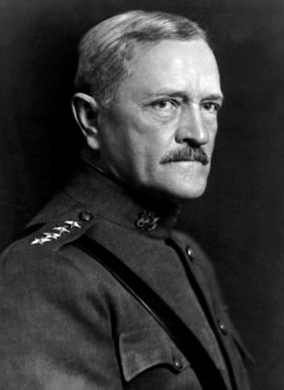
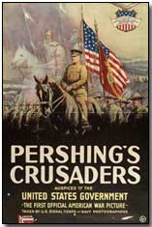
Pershing’s Crusaders: The Doughboys
American Expeditionary Force (AEF)
General John J. Pershing
First major action in spring 1918

Slide 22
American Battles:1918
German Counter-offensive
Chateau-Thierry (2nd Battle of the Marne)
Belleau Wood (June 1918)
Meuse (river) - Argonne (forest) Offensive (Fall 1918)
November 11, 1918 - Armistice (cease-fire)

Slide 23
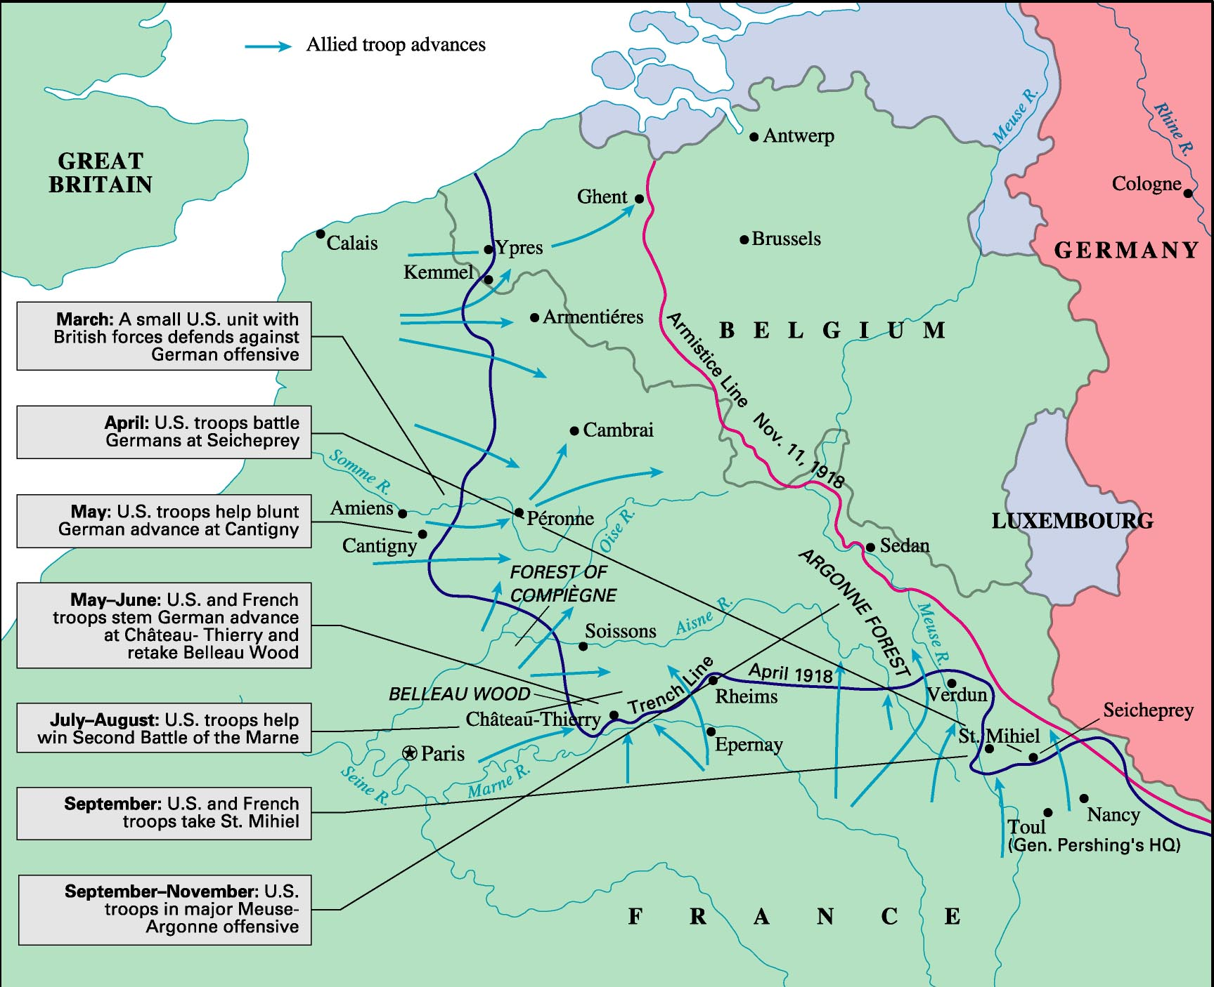
American Troops at the Western Front, 1918
Notes:
Figure 15: American Troops at the Western Front, 1918 ©Houghton Mifflin

Slide 24
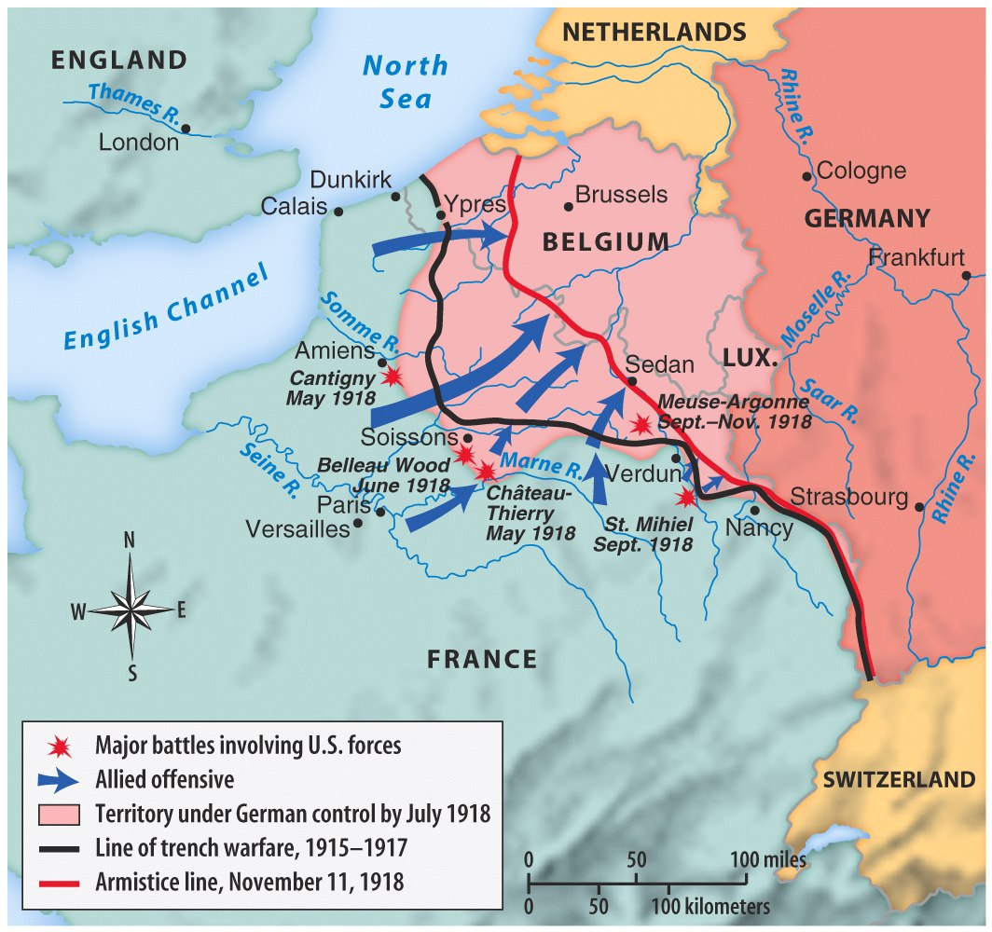
Map 22.2 U.S Participation on the Western Front, 1918 (p. 644)
Notes:
Map 22.2 U.S Participation on the Western Front, 1918 (p. 644)© Bedford St. Martin’s

Slide 25
Ending the War (1918)
Kaiser Wilhelm abdicates on November 9th 1918
11th hour of the 11th day of the 11th month in 1918 Germany agrees to a cease-fire (armistice)
8.5 million soldiers dead
21 million soldiers wounded
Cost of war= $338 billion

Slide 26
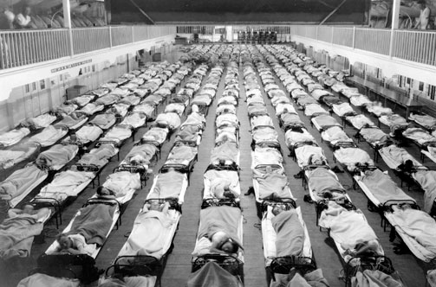
American Casualties
50,000 Americans died in 1918 combat
1918 Influenza epidemic (worldwide) killed thousands of soldiers and millions of people around the globe
112,000 American fatalities

Slide 27
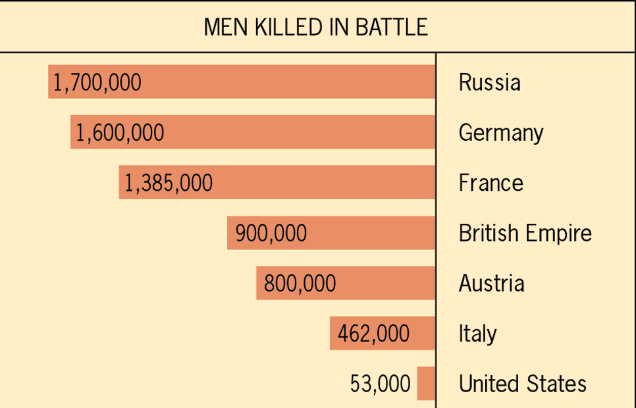
Approximate Comparative Losses in World War I
Notes:
Figure 31.1: Approximate Comparative Losses in World War I ©Houghton Mifflin

Slide 28
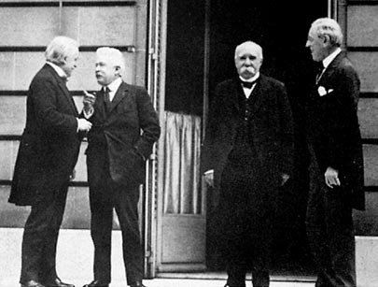
Winning the Peace: The Versailles Peace Conference
Paris and Palace of Versailles
Big Four:
Woodrow Wilson (USA)
David Lloyd George (GBR)
Georges Clemenceau (FR)
Orlando Vittorio (IT)
Russia excluded
Defeated powers humiliated
Wilson’s 14 points the major proposal

Slide 29
Wilson’s 14 Points
To “make the world safe for democracy”
#1-5 - international law recommendations
#6-13 - European boundary restructure
#14 - League of Nations

Slide 30
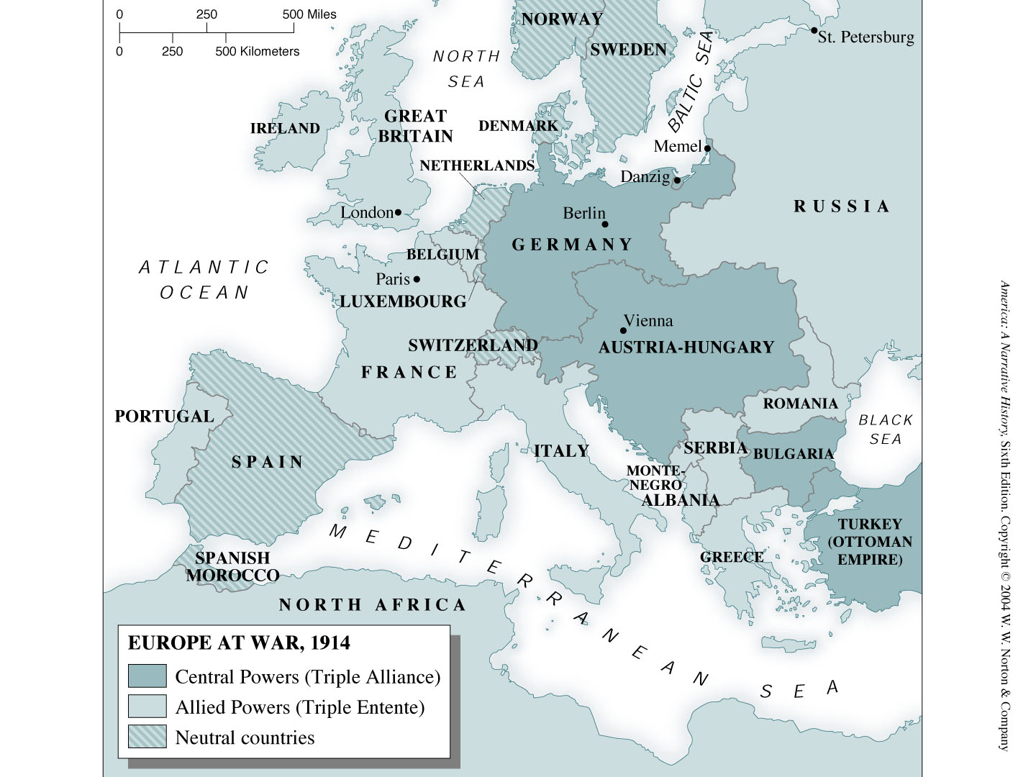
page1012.jpg
Notes:
Map: Europe at War, 1914

