Slide 1
The Vietnam War Years 1945-1975

Slide 2
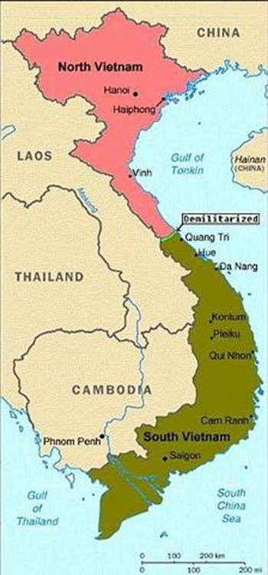
Phase 1 – War of Independence vs. France 1945-1954
1887-1941: Vietnam, Cambodia, and Laos had been a French colony under the name of French Indochina
Ho Chi Minh, a Communist, became leader of the Vietminh, a nationalist group who fought against Japan in WWII
1954: French defeated at Dien Bien Phu
Geneva Accords (Peace Conference): partitioned Vietnam at the 17th parallel into a communist North led by Ho and a “democratic” South Vietnam led by Ngo Dinh Diem

Slide 3
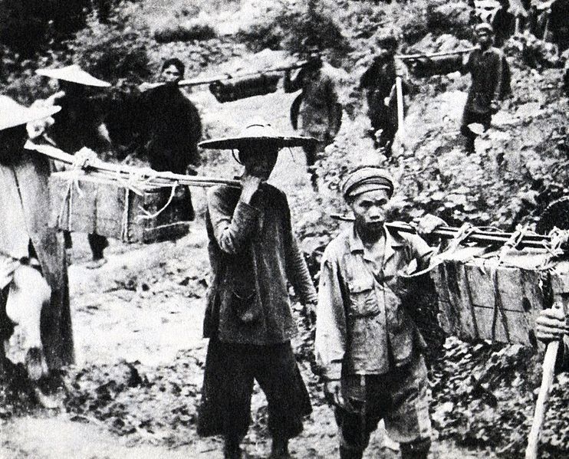
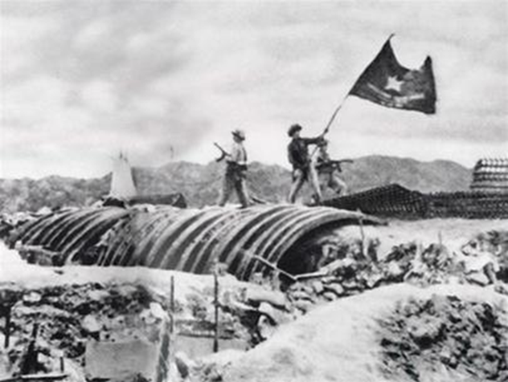
PHASE 2 – AMERICAN ESCALATION AND MILITARY INVOLVEMENT
Ho created the Vietcong, a guerrilla army to help unify the north and south under communism
Presidents Eisenhower and later JFK provide financial aid and military advisers to help the South fight the Vietcong
Domino theory: US belief that it Vietnam fell to communism, so would other nations in area (Pres. Eisenhower)

Slide 4
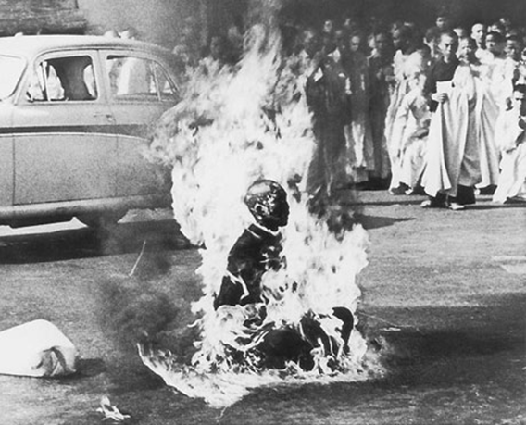
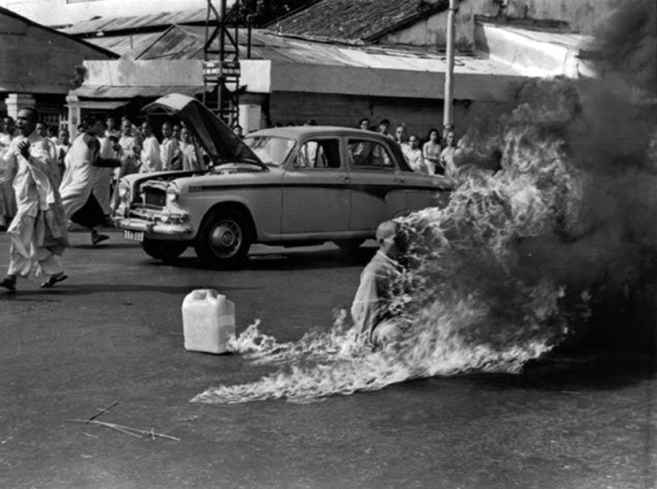
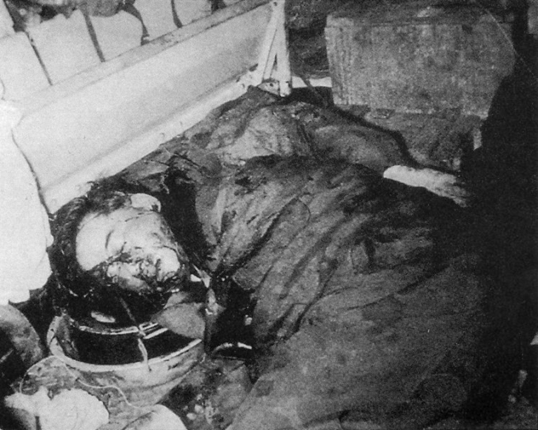
1963: Diem regime corrupt and unpopular; he was assassinated by military leaders

Slide 5
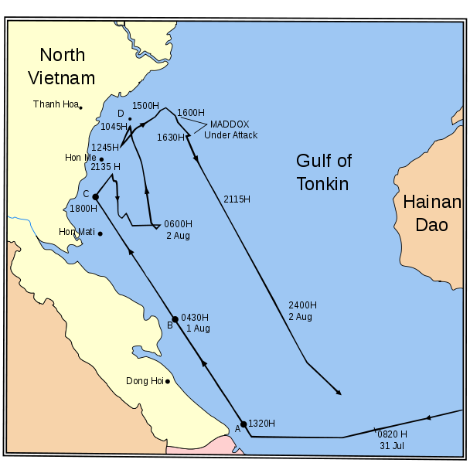
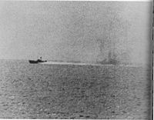
August 2, 1964: US claimed that North Vietnamese torpedo boats had fired on two US ships in the Gulf of Tonkin
August 7, 1964: Congress passed the Gulf of Tonkin Resolution which gave President Lyndon Johnson (LBJ) authority to “take all necessary measures” in Vietnam (blank check $$)
Congress had delegated all war powers to the President

Slide 6
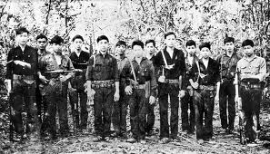
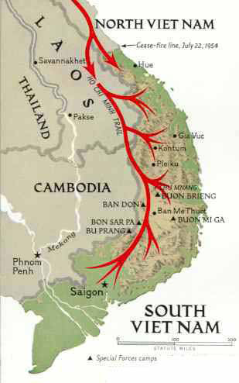
By end of 1965, 180,000 American combat troops were fighting in Vietnam
Vietcong used guerilla tactics and blended in with local population http://goo.gl/cmdJ4
Ho Chi Minh Trail - a supply line that ran between North and South Vietnam through Laos and Cambodia
Operation “Rolling Thunder” – 3 year bombing campaign against North Vietnam

Slide 7
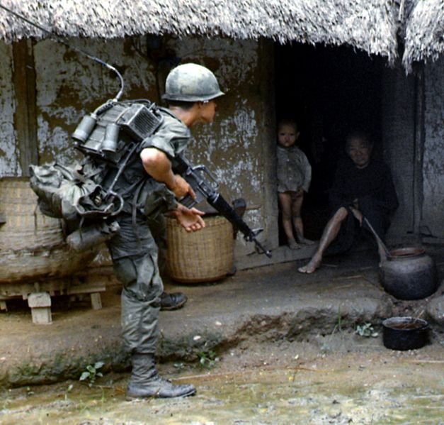
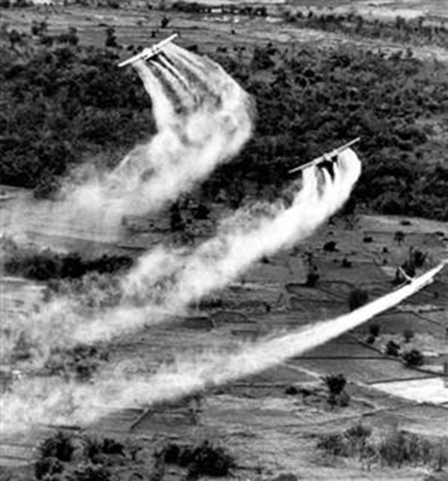
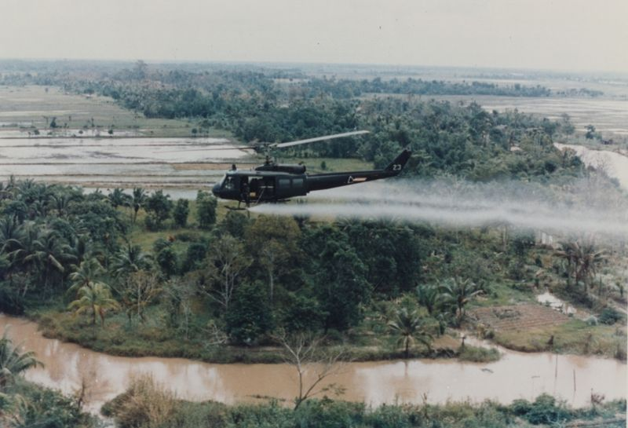
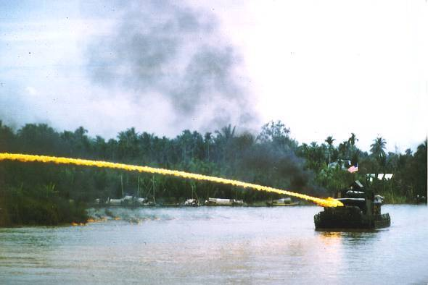
US tactics:
Troops began “search and destroy” missions
Airstrikes
Napalm
Agent Orange

Slide 8
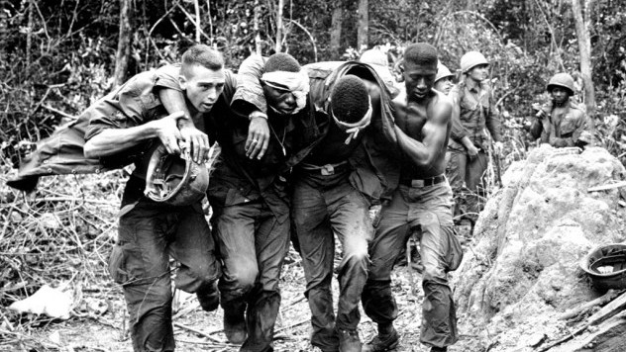
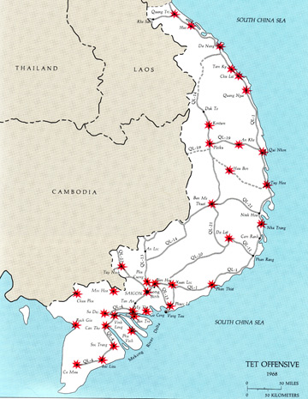
“Credibility Gap” – difference between what the US government said and what people saw and heard on TV about the war
January 30, 1968: Tet Offensive, a surprise communist offensive on a major Vietnamese holiday
Militarily unsuccessful but TV images made it seem like war was lost
“War is Unwinnable”

Slide 9
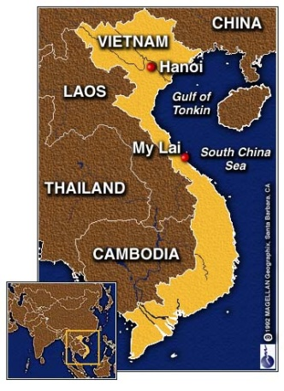
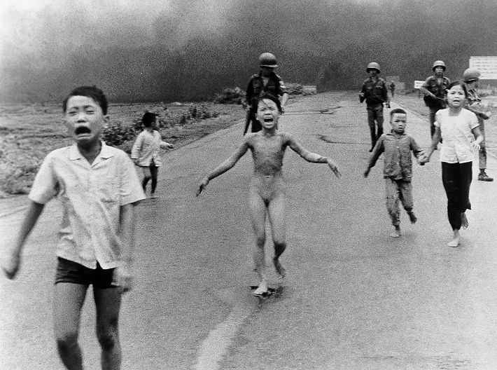
Vietnam was the first “TV War”
Viewers saw American atrocities at My Lai and the destruction caused by napalm and Agent Orange
http://goo.gl/RNJ6d

Slide 10
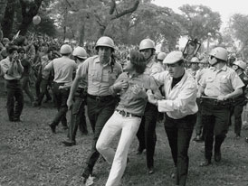
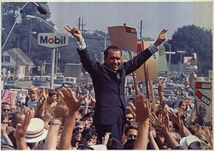
1967-1968: Protest at home intensifies
Doves: those opposed to the war
Hawks: those in favor of staying and fighting in Vietnam
Richard Nixon elected president – promised “Peace with Honor” and order at home

Slide 11
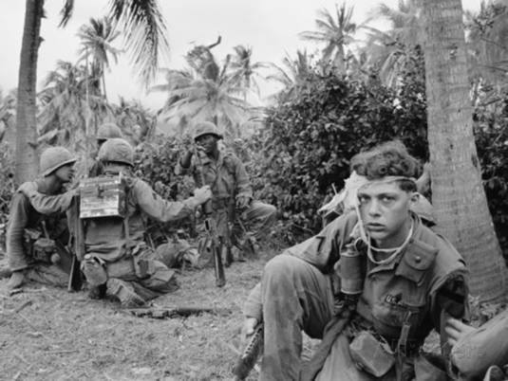
PHASE 3 – THE NIXON YEARS
Nixon relied on the diplomacy of Henry Kissinger to achieve peace or US withdrawal
Nixon pushed for Vietnamization: having the South Vietnamese take a greater role in the war
April 1970: In spite of that, he continues carpet bombing Hanoi and orders a secret invasion of Cambodia

Slide 12
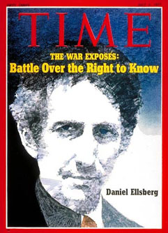
May 4, 1970: Kent State Massacre: Ohio National Guard opened fire on student protestors, 4 killed http://www.youtube.com/watch?v=YnOoNM0U6oc
1971: Daniel Ellsberg leaked Pentagon Papers – classified documents that showed gov’t officials privately questioning the war while publicly supporting it http://www.youtube.com/watch?v=F4kQG1bPf2k
January 27, 1973: Paris Peace Agreement signed →end the war and bring U.S. troops home (March 1973)

Slide 13
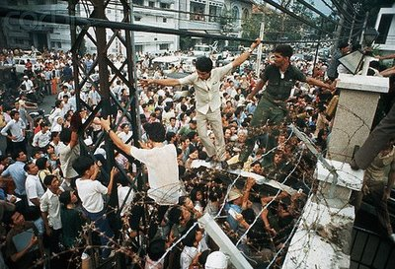
PHASE 4 – VIETNAMESE CIVIL WAR, 1973-75
March, 1975: North Vietnamese launch full-scale invasion of South Vietnam
April 30, 1975: Country unified under communism, Ho Chi Minh declares war over
Last 10 Americans leave U.S. Embassy

Slide 14
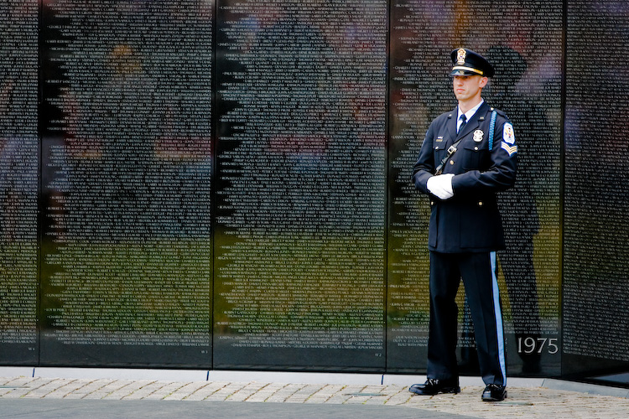
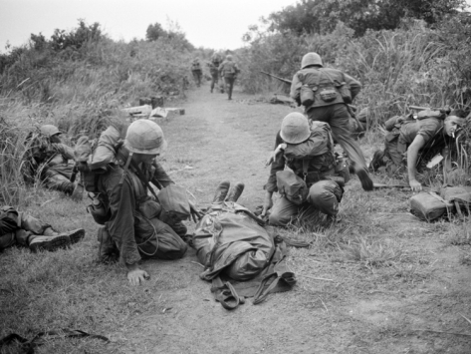
IMPACTS OF THE WAR
$170 billion direct costs
58,000 American soldiers dead
300,000 wounded
Over 1 million North & South Vietnamese soldiers dead + countless civilians

Slide 15
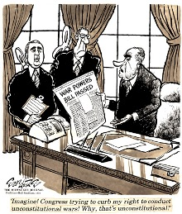
IMPACTS OF THE WAR
War Powers Act (1973)
President must inform Congress of troop commitments within 48 hours
Troops must be withdrawn in 60-90 days unless Congress approves usage
Public confidence in the US government declines

