Slide 1
Rise of Nazi Germany

Slide 2
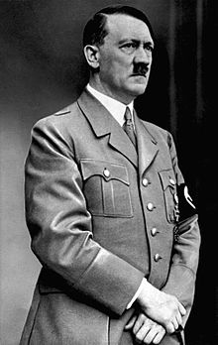
Adolf Hitler
Soldier during WWI
Became member of National Socialist German Workers Party (Nazi Party) in 1919, and head of it by 1921.
Core beliefs
Anti- Semitism
Nationalism

Slide 3
By 1931, the Nazis became largest party in German parliament
Enabling Act is passed 1933
Appoints Hitler as Chancellor (dictator)
Churches and Schools brought under control of Nazi regime
Concentration camps (large prison camps) set up for those who opposed the regime

Slide 4
Goals of Nazi Party
Create Aryan racial state that would dominate the world
Empire that rivaled Rome
Use of terror and repression to coerce opponents
Rearmament program
Get Germans back to work

Slide 5
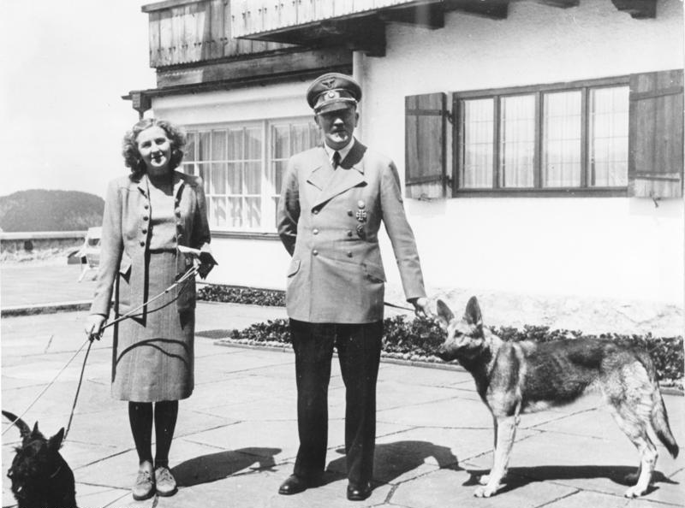
Women
Role as bearers of Aryan children
Wives and mothers

Slide 6
Nuremberg Laws
September of 1935
Excludes Jews from German citizenship
Jews required to wear yellow Star of David and carry ID cards saying they were Jewish
Marriage between Jews and German citizens forbidden
*A Jew was defined not by religion, but by whether or not he/she had a Jewish grandparent.

Slide 7
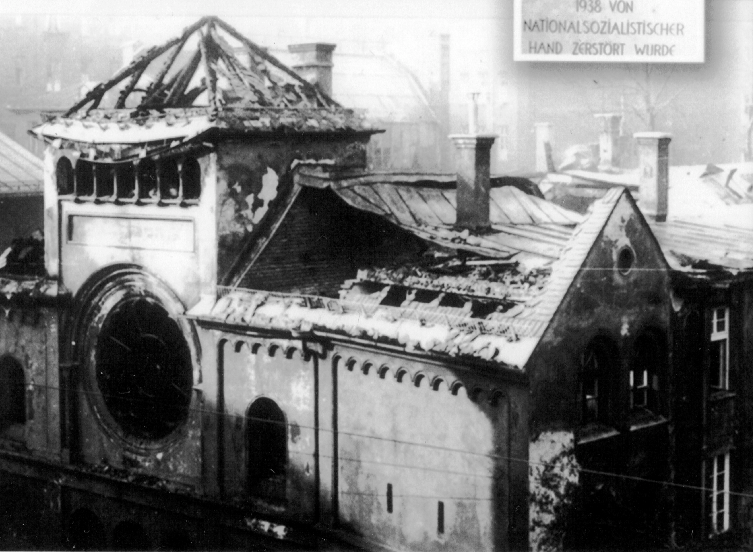
Kristallnacht
“Night of Shattered Glass”
November 1938
Destructive rampage against the Jews
Nazis burned synagogues, 7000 Jewish businesses
At least 100 Jews were killed
30,000 Jewish males were rounded up and sent to Concentration camps

Slide 8
Kristallnacht (continued)
Jews were now banned from all public transportation and all public buildings, including schools and hospitals
Prohibited from owning, managing, or working in any retail store
Jews forced to clean up the debris from Kristallnacht

Slide 9
The SS tells Jewish community, “emigrate from Germany”
And the Holocaust begins…..

