Slide 1
Imperialism

Slide 2
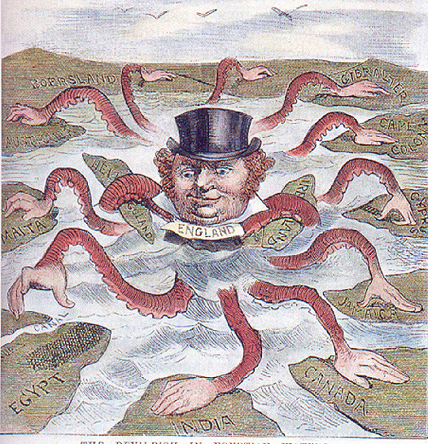
Causes for Imperialism
Source of raw materials (natural resources) for industrial economies.
Markets for those industrial economies’ products.

Slide 3
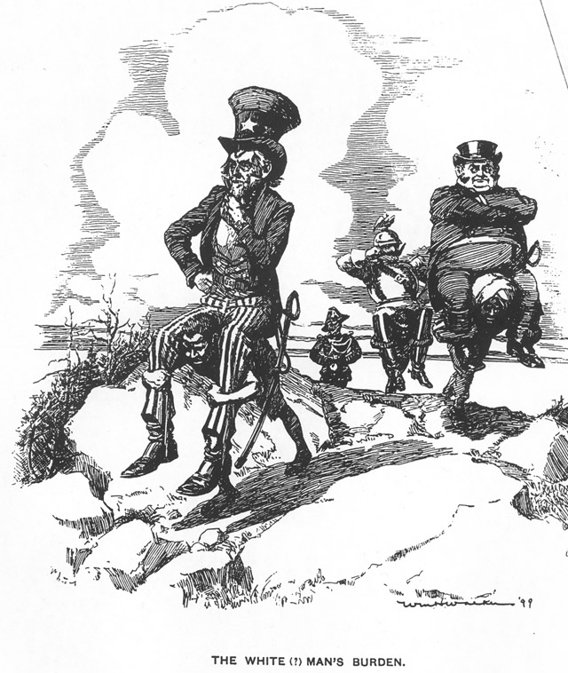
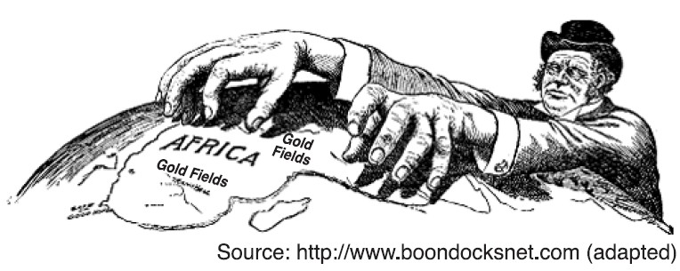
New Imperialism vs. Old Imperialism
New = Direct control of colonies (Africa)
Economics
Power/prestige
Social Darwinism/racism
“White Man’s Burden”
Spread of Democracy and Capitalism
Strategic: Suez Canal, Panama Canal, Monroe Doctrine

Slide 4
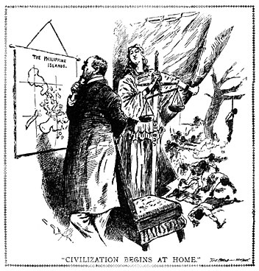
Resistance to Imperialism/ Colonialism
Ruling class did not want to lose power
Peasant revolts (plantation agriculture)
Westernized intellectuals (educated in society) organizing opposition

Slide 5
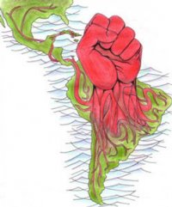
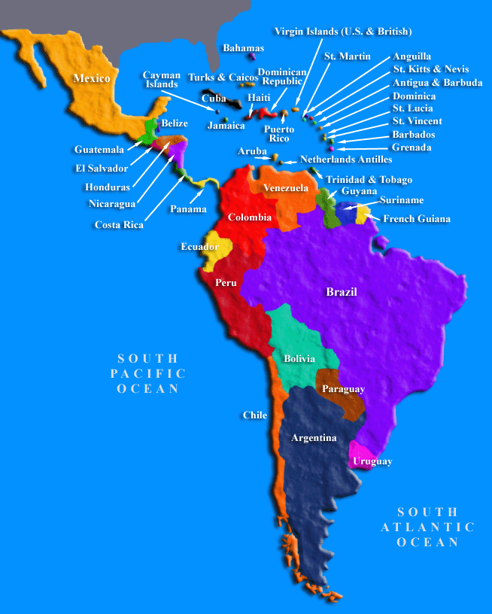
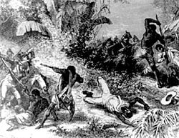
Latin America
Imperialized by Spain in the 1500s
Revolutionary ideas in Latin America were sparked by the successes of revolutions in North America and France

Slide 6
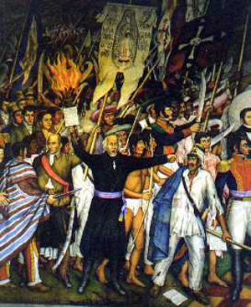
Mexico
Miguel Hidalgo-priest, influenced by French Revolution
rallied Native Americans and Mestizos to revolt
Formed mob army and attacked Spaniards on September 16, 1810 (still Mexico’s independence day)

Slide 7
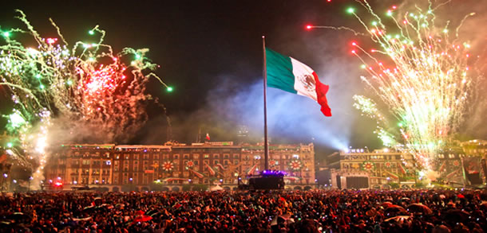
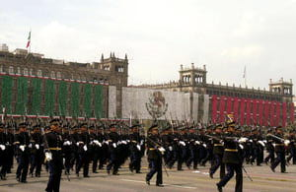
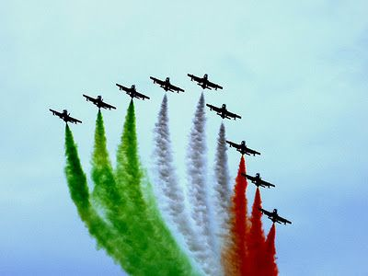
Mexico independent from Spain in 1821.

Slide 8
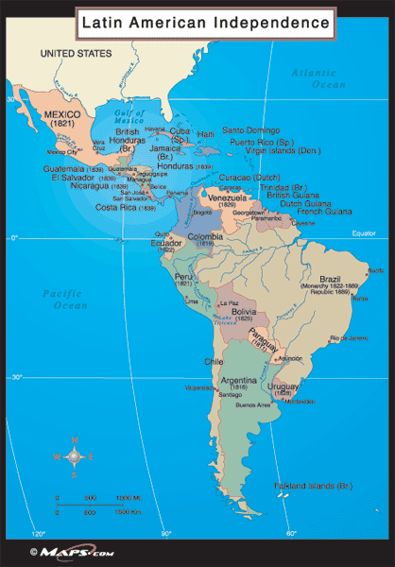
By the end of 1824, almost all of Latin America independent!

Slide 9
Monroe Doctrine
U.S. tells Europe that Western Hemisphere is off limits to colonization by European Powers
U.S. “gets” this side of the world
James Monroe

Slide 10
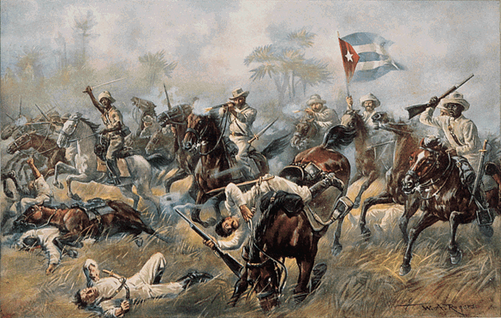
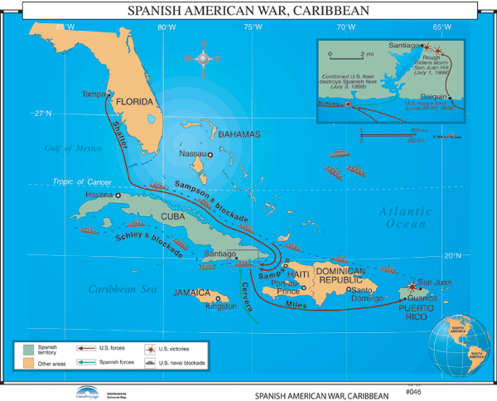
U.S. involvement in Latin America
U.S. fights Spanish in Spanish-American War (U.S. wins) 1898
Cuba becomes U.S. protectorate
Puerto Rico annexed to the U.S.

Slide 11
U.S. supports Panama rebellion that allowed Panama to separate from Colombia
Result → U.S. builds Panama Canal

Slide 12
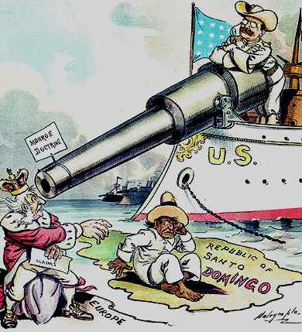
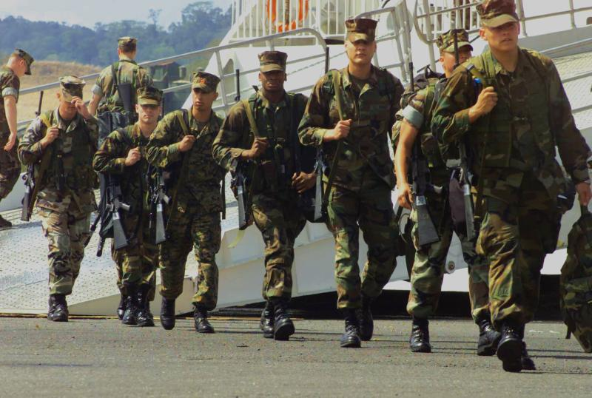
Many Latin American nations began to resent the “big bully” to the north.

Slide 13
Asia

Slide 14
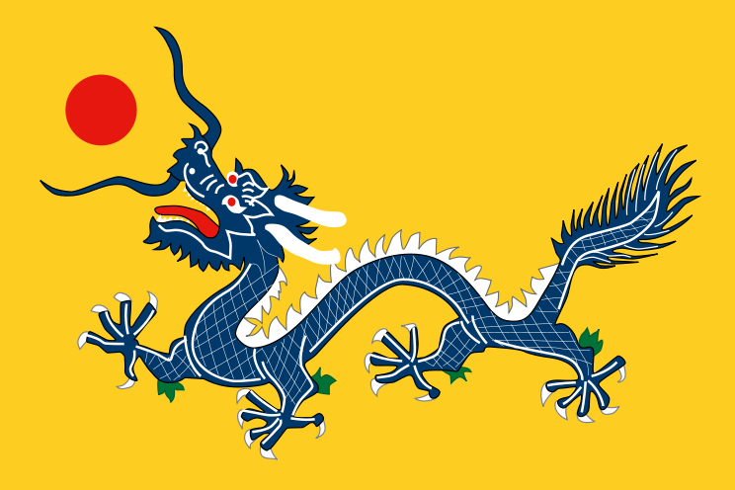
Decline of the Qing Dynasty
Finally, China experiencing contact with the west
China’s increasing population leads to unrest
Chinese Govt. full of corruption and not willing to change.
Flag of the Qing Dynasty 1889

Slide 15
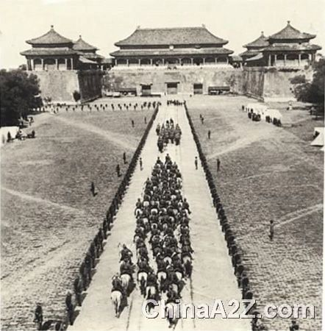
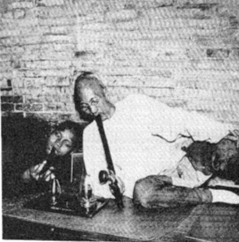
Opium War (1839-1842)
GB wanted more access to trade and had a trade deficit with China.
>Chinese said No on more access to trade
> due to GB trade deficit
>GB Began selling opium in China
China asked them to stop, GB said no.
War was short and GB won:
*Access to more trading ports
*Lower taxes on British goods
*Hong Kong

Slide 16
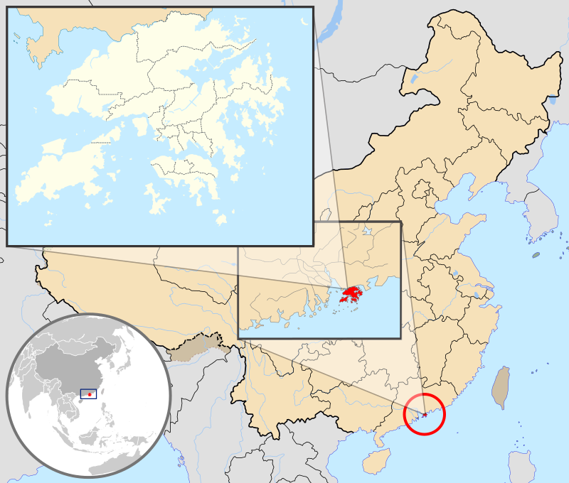
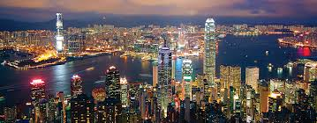
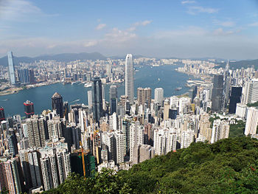
Extraterritoriality
Sections of town not under Chinese control.
Example:
Hong Kong under British Rule until 1997
Hong Kong

Slide 17
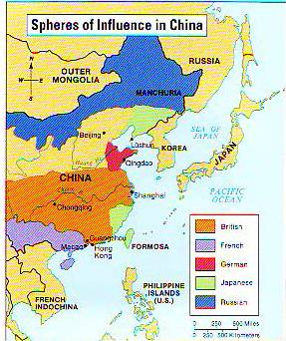
Spheres of Influence
Many countries in China now.
Areas occupied allow exclusive trading rights to that country
Gathering countries/territories outside of your country.

Slide 18
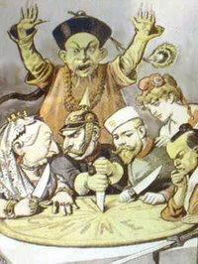
Open Door Policy
U.S. policy/treaty
Stabilized Chinese Economy/Markets
Technically put end to spheres of influence

Slide 19
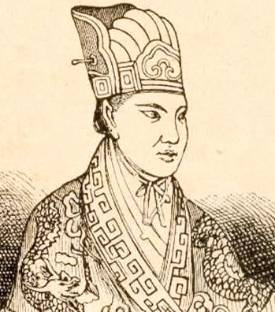
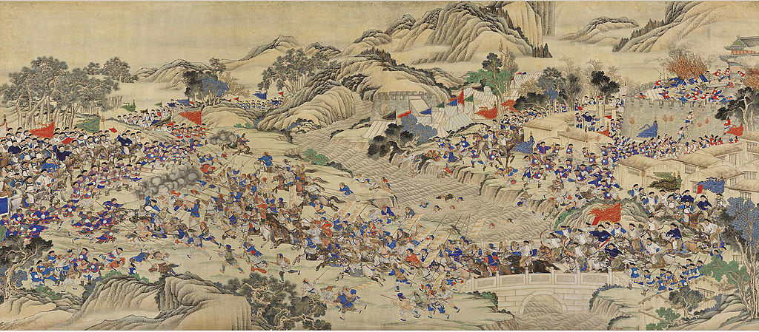
Tai Ping Rebellion (1850-1864)
Christian converts
Wanted to overthrow Qing dynasty and wanted reform
20 million die in Civil War
Very bloody
Europe eventually intervenes to help the Chinese Govt.

Slide 20
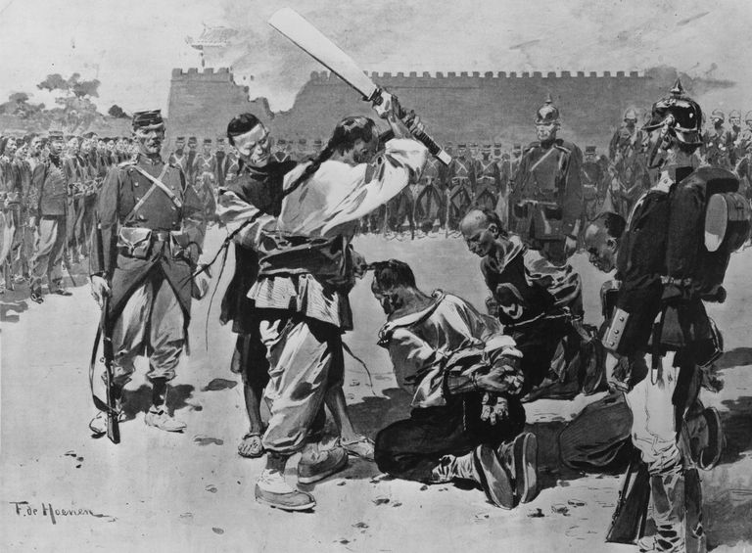
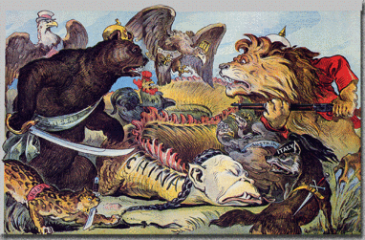
Boxer Rebellion (1900)
Secret Organization called Society of Harmonious Fists.
Rebellion- Killing of foreign missionaries and representatives.
A Coalition (European) responded and crushed them.

Slide 21
Sun Yat-Sen
Formed Nationalist Party→ democratic
1911- Organized uprising which led to the end of the Qing Dynasty
Now China suffering from Instability and Civil War
Did not change political or social order
**During WWI- European powers unable to continue domination of Chinese markets

Slide 22
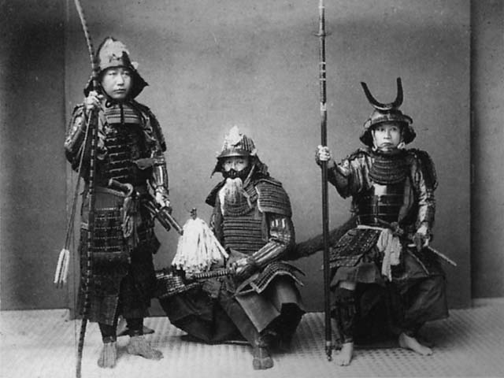
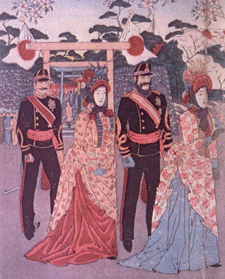
Japan
The Samurai
Industrialized early
Western nations want to trade
Desires for westernization resisted by some (Samurai)
Japanese government officials began to study and implement western practices (Meiji Restoration)
Europeans in Japan during Meiji Restoration

Slide 23
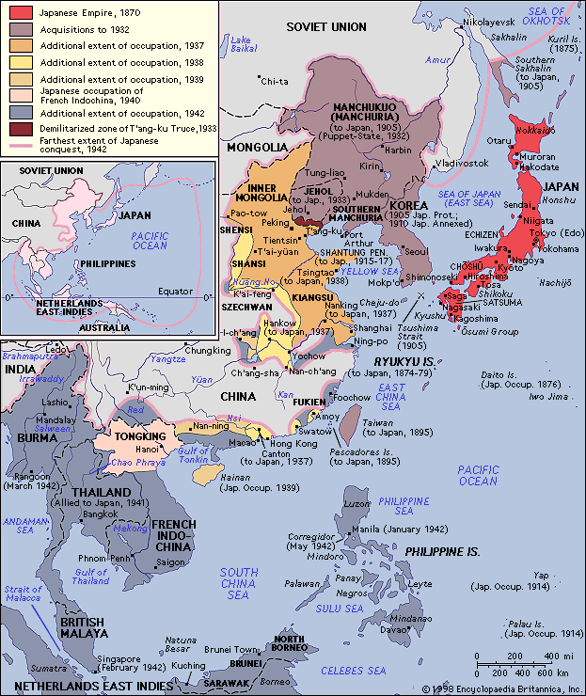
Japanese Imperialism
Move into Korea and China
War with Russia in 1904
Expansion of power in Asia (U.S. vs. Japan)

Slide 24
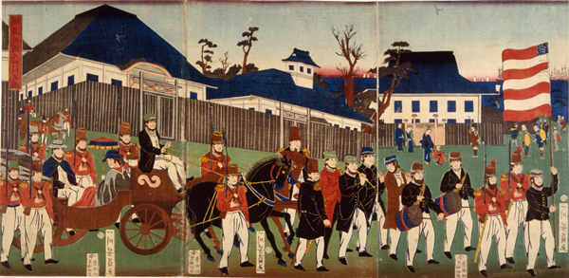
U.S. Relations with Japan
U.S. recognized role of Japan in Korea if Japan recognized American authority in Philippines.
1910 Japan annexed Korea
U.S. suspicious as Japan becomes World Power.

